Slide 1
Section 1
Week of February 4

Slide 2
Outline
A few notes
Git
HTML
CSS/SASS
Responsive Design

Slide 3
A few notes:
Project 0 is due Monday February 11th
Encourage all students to keep video on in office hours and section, though audio muted unless speaking
Encourage many many questions through the chat box throughout section

Slide 4
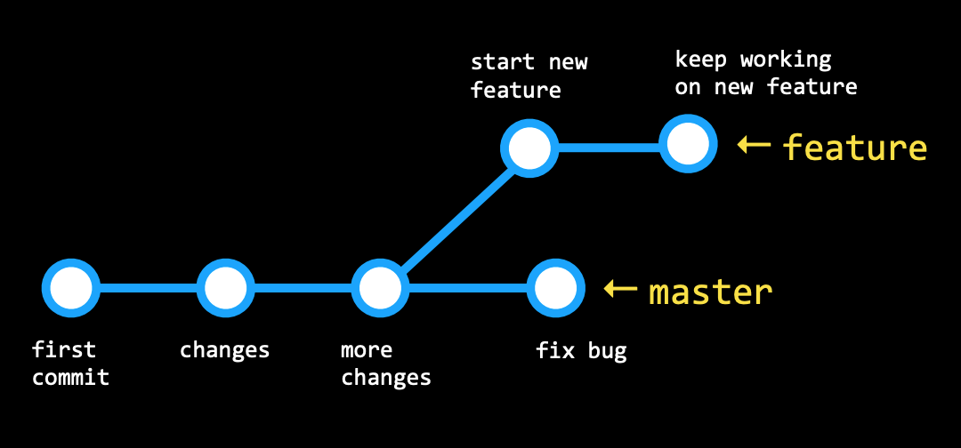
Git: Branching
Useful commands:
git branch
git branch new-branch
git branch -d branch-name
git checkout branch-name
git merge branch-name
git push --set-upstream origin new-branch
Keywords: remote, fork, pull request, HEAD, origin, master

Slide 5


HTML Links
<a href=[URL or Filename or ID]> Click Me! </a>
Recall: example file structure from section 0:
2019cscie33
section_0
index.html
page2.html
Keywords: directory

Slide 6
HTML5 Features
New tags: https://www.wpkube.com/html5-cheat-sheet/
Examples:
<header>
<nav>
<section>
<footer>
<audio>
<video>
<datalist>
Support for HTML5 on all major browsers

Slide 7
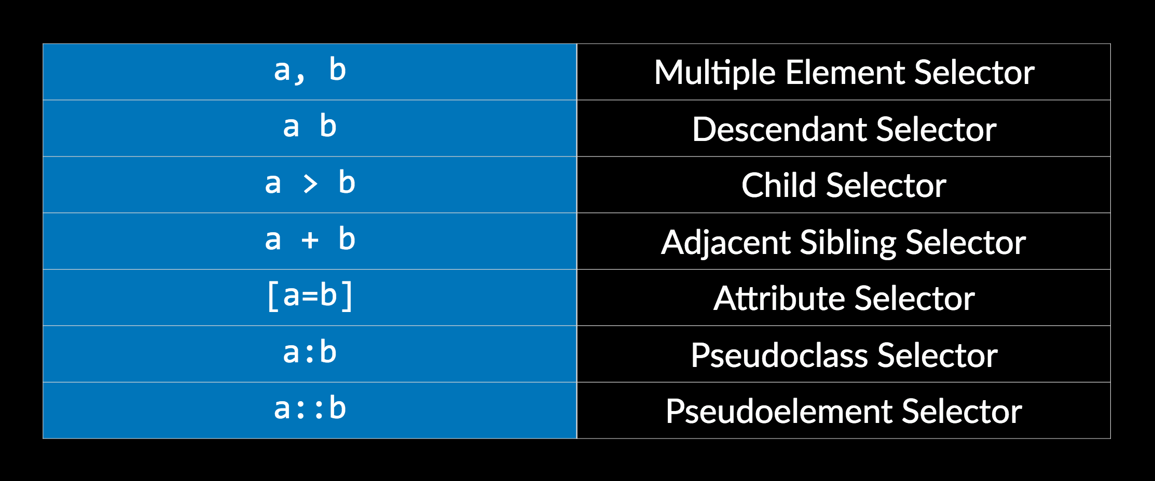
Advanced CSS
Notes:
Also ask at end: what is bootstrap?

Slide 8
Sass: Syntactically Awesome Style Sheets
Features:
Use nesting and variables in css code
Compile sass code into css code using Sass (may need to download)
Useful commands:
Sass style.scss style.css
Sass --watch style.scss:style.css
Keywords: inheritance, template

Slide 9
Responsive design: Media queries
Purpose: Made websites responsive to different device sizes
Media queries: https://www.w3schools.com/cssref/css3_pr_mediaquery.asp
@media not|only mediatype and (mediafeature and|or|not mediafeature) {
CSS-Code;
}

Slide 10
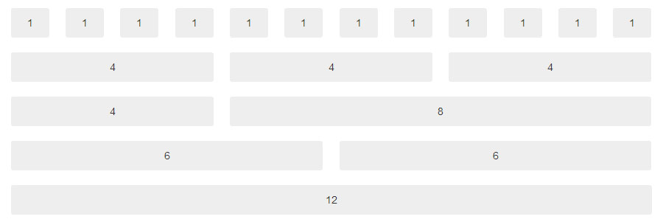
Responsive design: Bootstrap
Bootstrap 4: https://getbootstrap.com/docs/4.2/getting-started/introduction/
Link in header: <link rel="stylesheet" href="https://stackpath.bootstrapcdn.com/bootstrap/4.2.1/css/bootstrap.min.css" integrity="sha384-GJzZqFGwb1QTTN6wy59ffF1BuGJpLSa9DkKMp0DgiMDm4iYMj70gZWKYbI706tWS" crossorigin="anonymous">
Grid layout:
Example:
<div class=”row”>
<div class=”col-3”>
</div>
</div>
Source: https://dzone.com/articles/working-with-bootstrap-4-grid-system-for-creating

Slide 11
Any remaining questions?

